Slide 1
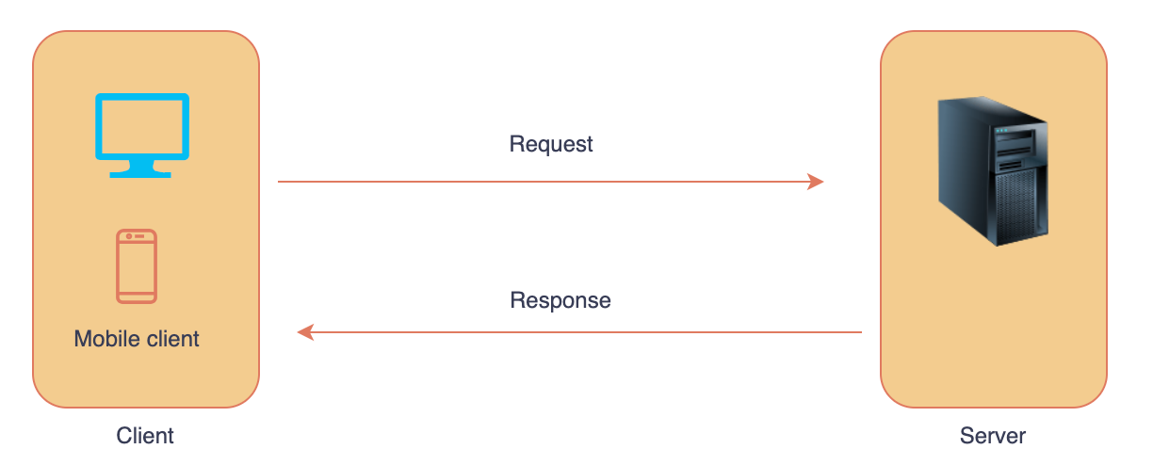
Client-Server Architecture
--Rachakonda Sushmitha

Slide 2
What is Client-Server Architecture?
Client-server architecture is a networking model where resources and services are provided by a server and requested by clients over a network.
This model divides the system in two parts client side and server side.

Slide 3
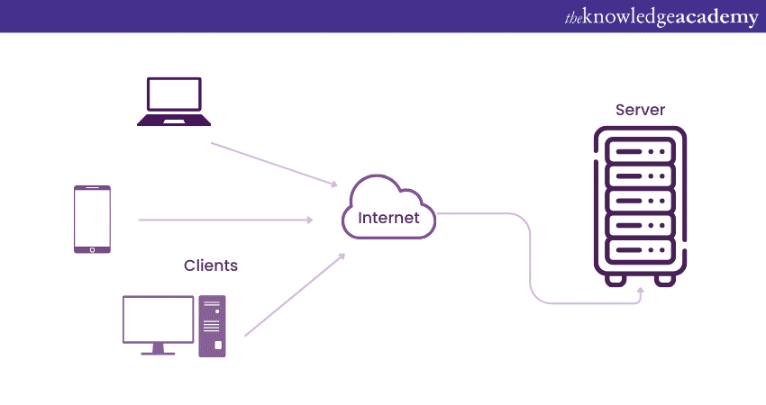
Components
Client-Server Architecture depends on three main components that need to work together for it to function.

Slide 4
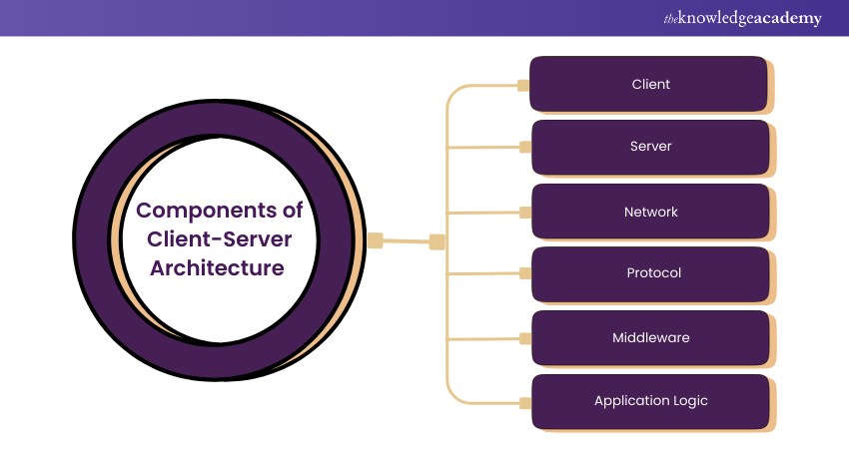

Slide 5
How It Works
Client sends a request via the network.
Server processes the request.
Server sends a response.
Client receives and handles the response.

Slide 6
Examples
Email Servers
File Servers
Web Servers (e.g. Browsing a website)

Slide 7
Types
One-tier Architecture
Two-tier Architecture
Three-tier Architecture
N-tier Architecture

Slide 8
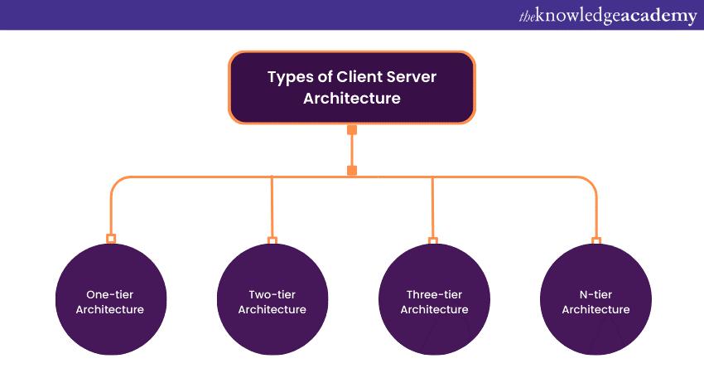

Slide 9
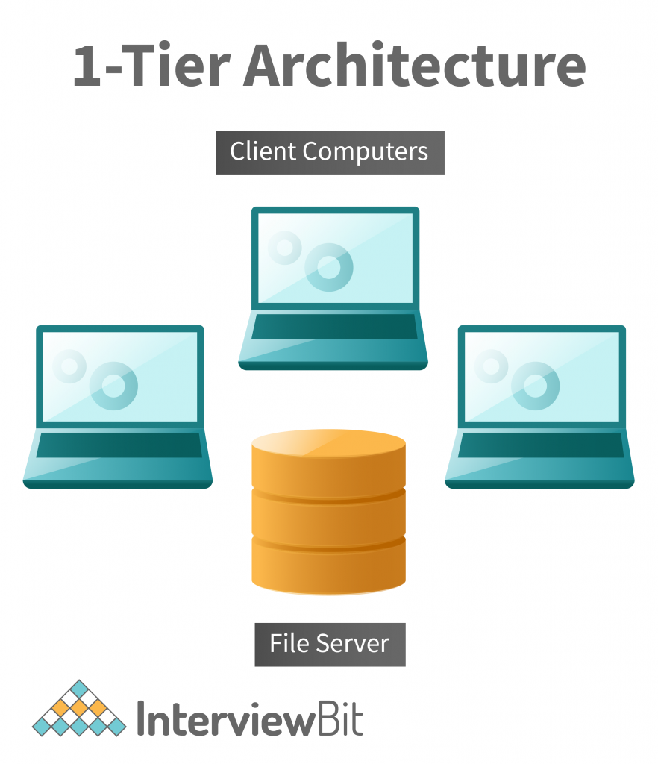
One-tier Architecture
A self-contained application on a single platform. In one-tier architecture, the client, server, and database are all on the same machine

Slide 10
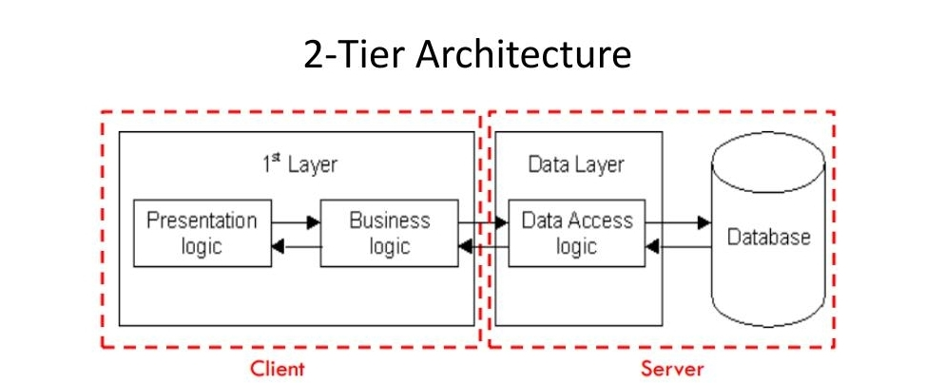
Two-tier Architecture
This basic Client-Server Architecture involves direct communication between the client and server without an intermediate layer.

Slide 11
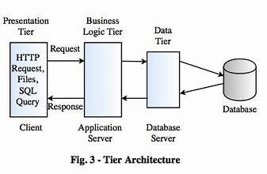
Three-tier Architecture
A more complex client-server setup with an intermediate layer (usually middleware or an application server) that handles business logic, acting as a bridge between the client and server.

Slide 12
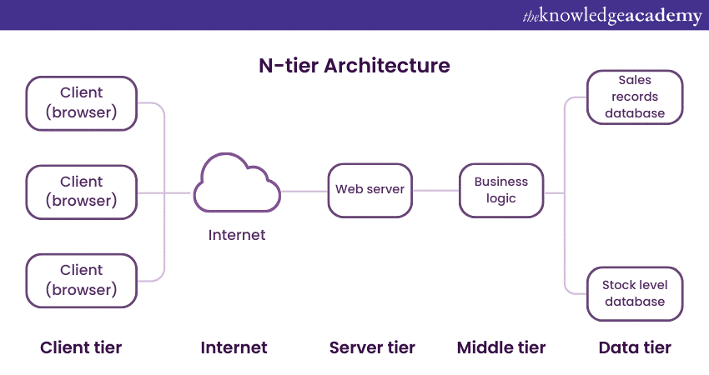
N-tier Architecture
A more flexible Client-Server Architecture with more than three tiers, allowing greater scalability, flexibility, and modularity.

Slide 13
Conclusion
Client Server Architecture is a powerful and flexible way of managing network resources and applications.

Slide 14


